Slide 1
Public B-Corp Index
Methodology Details – May 2024

Slide 2
Construction of the B-Corp Index
1. DATA COLLECTION & VALIDATION
2. INTERNATIONAL EXCHANGES
Data sources and how we filter and combine information
Mapping of each stock to the respective exchange
3. METHODOLOGY ALGORITHM
4. RECONSTITUTION & PERFORMANCE CALCULATION
Creation and optimization of the index algorithms
Annual reconstitution and performance calculation

Slide 3
1. Data Collection & Validation
Source 1: List of public B Corps published by B Labs, accessed through data.world
Includes exchange and ticker
Includes trading history
Includes certification

Slide 4
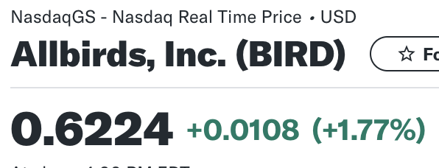
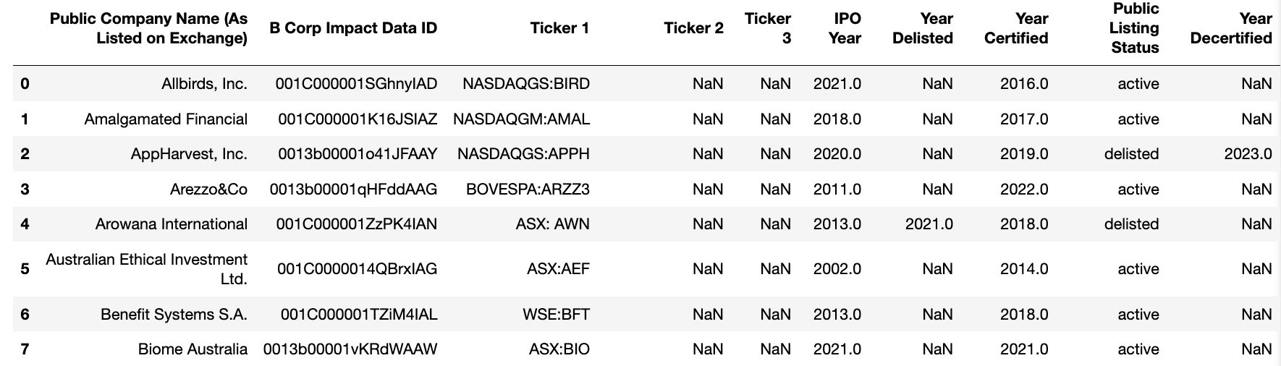
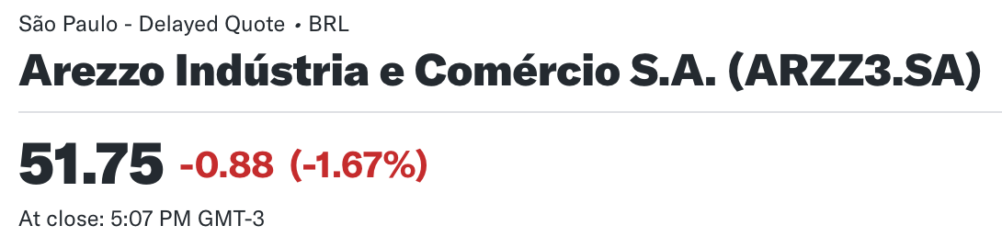
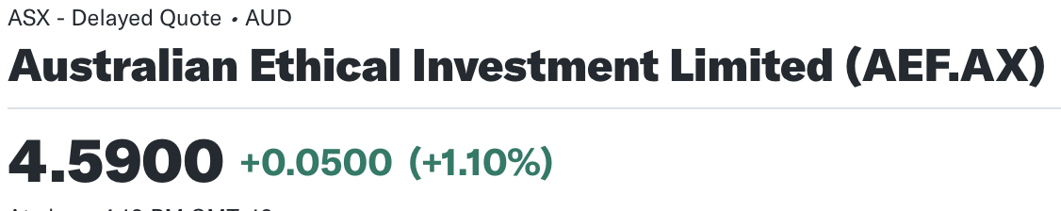
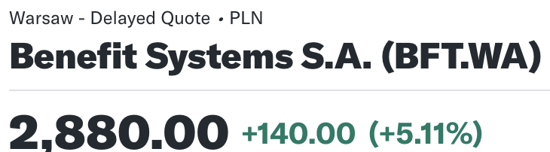
Quality Control and Exchange Mapping
- Check to make sure stocks are listed, then map each exchange to Yahoo Finance code to be able to access price history.
- All price information reported in local (or exchange) currency
BIRD
ARZZ3.SA
AEF.AX
BFT.WA

Slide 6
This is a quote.
Words full of wisdom that someone important said and can make the reader get inspired.”
“
—Someone famous

Slide 7
Whoa!
It could be the part of the presentation where you can introduce yourself, write your email…

Slide 8
1.This is a great headline
And this is the subtitle that makes it comprehensible

Slide 9
The slide title goes here!
Do you know what helps you make your point clear? Lists like this one:
Because they’re simple
You can organize your ideas clearly
And because you’ll never forget to buy milk!
And the most important thing: the audience won’t miss the point of your presentation

Slide 10
Maybe you need to divide the content
MERCURY
VENUS
Mercury is the closest planet to the Sun and the smallest one in the Solar System—it’s only a bit larger than our Moon. The planet’s name has nothing to do with the liquid metal
Venus has a beautiful name and is the second planet from the Sun. It’s terribly hot—even hotter than Mercury—and its atmosphere is extremely poisonous

Slide 11
You could use three columns, why not?
MARS
JUPITER
SATURN
Despite being red, Mars is a cold place, not hot. The planet is full of iron oxide dust
It’s the biggest planet in our Solar System and the fourth-brightest object in the sky
Yes, this is the ringed one. It’s a gas giant, composed mostly of hydrogen and helium

Slide 12
Sometimes, reviewing concepts is a good idea
VENUS
MERCURY
MARS
Venus has a beautiful name, but it’s terribly hot, even hotter than Mercury
Mercury is the closest planet to the Sun and is only a bit larger than our Moon
Despite being red, Mars is a cold place, not hot. The planet is full of iron oxide dust
JUPITER
SATURN
NEPTUNE
It’s a gas giant and the fourth-brightest object in the sky
Yes, this is the ringed one. It’s a gas giant, composed mostly of hydrogen and helium
Neptune is the fourth-largest planet in our Solar System and the farthest from the Sun

Slide 13
A picture always reinforces the concept
Images reveal large amounts of data, so remember: use an image instead of long texts. Your audience will appreciate that

Slide 14
A picture is worth a thousand words

Slide 15
Fantastic words
Because key words are great for catching your audience’s attention

Slide 16
This is a map

Slide 17
A timeline always
works fine
DAY 1
DAY 2
DAY 3
DAY 4
Venus has a beautiful name, but it’s terribly hot
Mercury is the closest planet to the Sun
Jupiter is the biggest planet in our Solar System
Despite being red, Mars is a cold place, not hot

Slide 18
Infographics make your idea understandable…
NEPTUNE
Neptune is the fourth-largest planet in our Solar System
MERCURY
Mercury is the closest planet to the Sun and is only a bit larger than our Moon
VENUS
Venus has a beautiful name, but it’s terribly hot, even hotter than Mercury
JUPITER
It’s a gas giant and the biggest planet in our Solar System

Slide 19
… and the same goes for tables
 | MASS (earths) | DIAMETER (earths) | SURFACE GRAVITY (earths)
MERCURY | 0,06 | 0,38 | 0,38
MARS | 0,10 | 0,60 | 0,53
SATURN | 9,54 | 9 | 7,8

Slide 20
Display data in graphs
DAY 1
Mercury is the closest planet to the Sun and is only a bit larger than our Moon
DAY 2
Neptune is the fourth-largest planet in our Solar System
DAY 3
Venus has a beautiful name, but it’s terribly hot, even hotter than Mercury
DAY 4
Jupiter is a gas giant and the biggest planet in our Solar System
If you want to modify this graph, click on it, follow the link,
change the data and replace it

Slide 21
9,256,147,158
Big numbers catch your audience’s attention

Slide 22
333,000.00
24h 37m 23s
386,000 km
earths is the Sun’s mass
is Jupiter’s rotation period
is the distance between the Earth and the Moon

Slide 23
Key words are great for catching your audience’s attention
Day 1
Mercury is the closest planet to the Sun and the smallest one in the Solar System—it’s only a bit larger than our Moon
Day 2
Venus has a beautiful name and is the second planet from the Sun. It’s terribly hot and its atmosphere is extremely poisonous

Slide 24
MARS
SATURN
Despite being red, Mars is a cold place, not hot. It’s full of iron oxide dust, giving the planet its reddish cast
Yes, this is the ringed one. It’s a gas giant, composed mostly of hydrogen and helium
JUPITER
MERCURY
It’s the biggest planet in our Solar System and the fourth-brightest object in the sky
Mercury is the closest planet to the Sun and the smallest one in the Solar System

Slide 25
A picture always reinforces the concept
Images reveal large amounts of data quickly, so remember: use an image instead of long texts. Your audience will appreciate that

Slide 26
The slide title goes here!
Do you know what helps you make your point clear? Lists like this one:
Because they’re simple
You can organize your ideas clearly
And because you’ll never forget to buy milk!

Slide 27
A picture always reinforces the concept
Images reveal large amounts of data quickly, so remember: use an image instead of long texts. Your audience will appreciate that

Slide 28
Use an image instead
of long texts
A picture always reinforces
the concept
Do you know what helps you make your point clear? Lists like this one:
1. Because they’re simple
2. You can organize your ideas clearly
Images reveal large amounts of data quickly, so remember: use an image instead of long texts. Your audience will appreciate that

Slide 29
The slide title goes here!
Do you know what helps you make your point clear? Lists like this one:
Because they’re simple
You can organize your ideas clearly
And because you’ll never forget to buy milk!

Slide 30
Words full of wisdom that someone important said and can make the reader get inspired.”
“
—Someone famous

Slide 31
Desktop Software
You can replace the image on the screen with your own work. Just delete this one, add yours and send it to the back

Slide 32
Mobile Web
You can replace the image on the screen with your own work. Just delete this one, add yours and send it to the back

Slide 33
Tablet App
You can replace the image on the screen with your own work. Just delete this one, add yours and send it to the back

Slide 34
Thanks!
Does anyone have any questions?
addyouremail@freepik.com
+91 620 421 838
yourcompany.com

Slide 35
Credits
This is where you give credit to the ones who are part of this project.
Did you like the resources on this template? Get them for free at our other websites.
Presentation template by Slidesgo
Icons by Flaticon
Images & infographics by Freepik
Pictures by Peoplecreations (slides 10, 18 & 21) and Freepik (slides 1, 2, 4, 5, 9, 19, 20, 22, 23, 24, 25, 26 & 31)

Slide 36
Instructions for use (free users)
In order to use this template, you must credit Slidesgo by keeping the Thanks slide.
You are allowed to:
Modify this template.
Use it for both personal and commercial purposes.
You are not allowed to:
Sublicense, sell or rent any of Slidesgo Content (or a modified version of Slidesgo Content).
Distribute this Slidesgo Template (or a modified version of this Slidesgo Template) or include it in a database or in any other product or service that offers downloadable images, icons or presentations that may be subject to distribution or resale.
Use any of the elements that are part of this Slidesgo Template in an isolated and separated way from this Template.
Delete the “Thanks” or “Credits” slide.
Register any of the elements that are part of this template as a trademark or logo, or register it as a work in an intellectual property registry or similar.
For more information about editing slides, please read our FAQs or visit Slidesgo School:
https://slidesgo.com/faqs and https://slidesgo.com/slidesgo-school

Slide 37
Instructions for use (premium users)
In order to use this template, you must be a Premium user on Slidesgo.
You are allowed to:
Modify this template.
Use it for both personal and commercial purposes.
Hide or delete the “Thanks” slide and the mention to Slidesgo in the credits.
Share this template in an editable format with people who are not part of your team.
You are not allowed to:
Sublicense, sell or rent this Slidesgo Template (or a modified version of this Slidesgo Template).
Distribute this Slidesgo Template (or a modified version of this Slidesgo Template) or include it in a database or in any other product or service that offers downloadable images, icons or presentations that may be subject to distribution or resale.
Use any of the elements that are part of this Slidesgo Template in an isolated and separated way from this Template.
Register any of the elements that are part of this template as a trademark or logo, or register it as a work in an intellectual property registry or similar.
For more information about editing slides, please read our FAQs or visit Slidesgo School:
https://slidesgo.com/faqs and https://slidesgo.com/slidesgo-school

Slide 38
Fonts & colors used
This presentation has been made using the following fonts:
Roboto
(https://fonts.google.com/specimen/Roboto)
#a5b7c6
#91aa9d
#3e606f
#193441

Slide 39
Use our editable graphic resources...
You can easily resize these resources keeping the quality. To change the color just ungroup the resource and click on the object you want to change. Then click on the paint bucket and select the color you want. Don’t forget to group the resource again when you’re done.

Slide 41
...and our set of editable icons
You can resize these icons keeping the quality.
You can change the stroke and fill color; just select the icon and click on the paint bucket/pen.

Slide 42
Business Icons

Slide 43
Avatar Icons

Slide 44
Creative Process Icons

Slide 45
Educational Process Icons

Slide 46
Help & Support Icons

Slide 47
Medical Icons

Slide 48
Nature Icons

Slide 49
Performing Arts Icons

Slide 50
SEO & Marketing Icons

Slide 51
Teamwork Icons

